Slide 1



Brand Elevate Proposal
3 in1 Category
Strengthening Market Leadership
and
Maximize the Customer Convenience & Experience

Slide 2
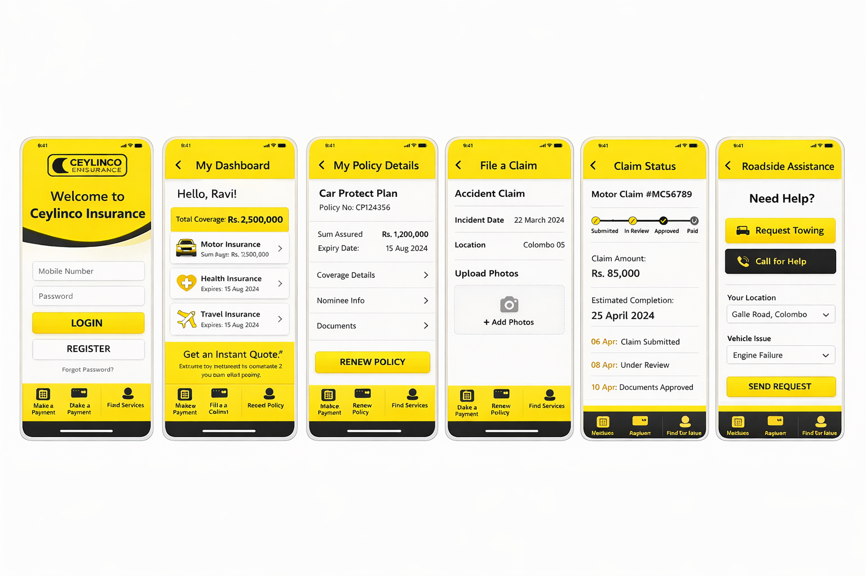

Convenient Insurance Wallet

Slide 3
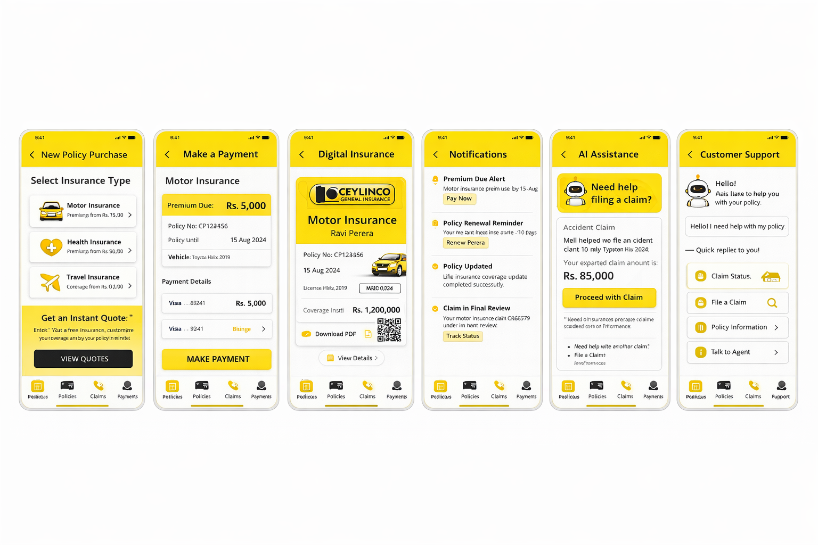
Convenient Insurance Wallet

Slide 4
Digital Innovation
Ceylinco VIP Insurance Wallet
Instant quotations
Online policy purchasing
Premium payments through mobile
Policy documents acknowledgement
Digital claims submission
Location Finders ( Branches/ Hospitals/ Garages)

Slide 5
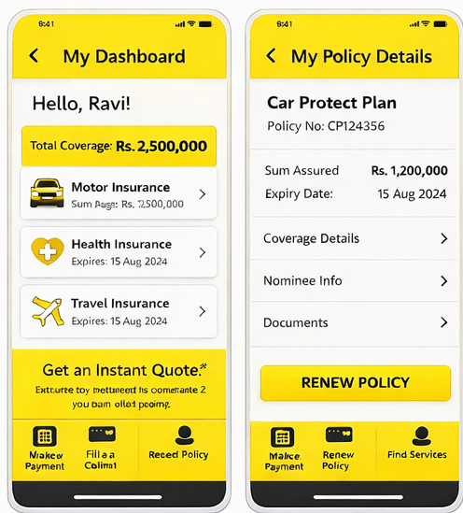
VIP Wallet Overview
Customer Profile & Dashboard
Vision
Customer registration and secure login
(OTP / biometric)
Personal profile management
View all active policies in one dashboard
Policy status, premium due dates
Policy coverage details
Policy Acknowledgement (Proposal/ CNC/ SI)
Digital insurance card / policy certificate

Slide 6
VIP Wallet Overview
Policy Management
View policy documents (PDF download)
Policy renewal reminders
Add new policies
Coverage details and benefits
Nominee / beneficiary details

Slide 7
VIP Wallet Overview
Premium Payment
Pay premiums online
(credit card / debit card)
Auto payment option
Payment history
Download premium receipts

Slide 8
VIP Wallet Overview
Claims Management
Submit claims through the app
Upload documents & photos
Track Assessor or Assign to Call Center
Track claim status
Notifications when claim progress updates
Claim payment process
Claim history

Slide 9
VIP Wallet Overview
Notifications & Alerts
Premium due reminders
Policy renewal alerts
Claim updates
Promotional offers

Slide 10
VIP Wallet Overview
Customer Support
Live chat with support team
Request a call back
Branch locator
FAQ section

Slide 11
Future Developments
Additional Smart Features
AI Powered Claim Settlement
AI chatbot for quick questions
Risk alerts
(flood/weather alerts for motor/property)
Wellness rewards / loyalty programs
Push notifications for important updates

Slide 12

THANK YOU..
02
Ceylinco General Insurance

